Slide 1

Springboard Data Analytics Program Capstone 2 Project Video Game Market Data for 1995-2016 Using Python and Tableau
Presenter: Adam Muffitt

Slide 2
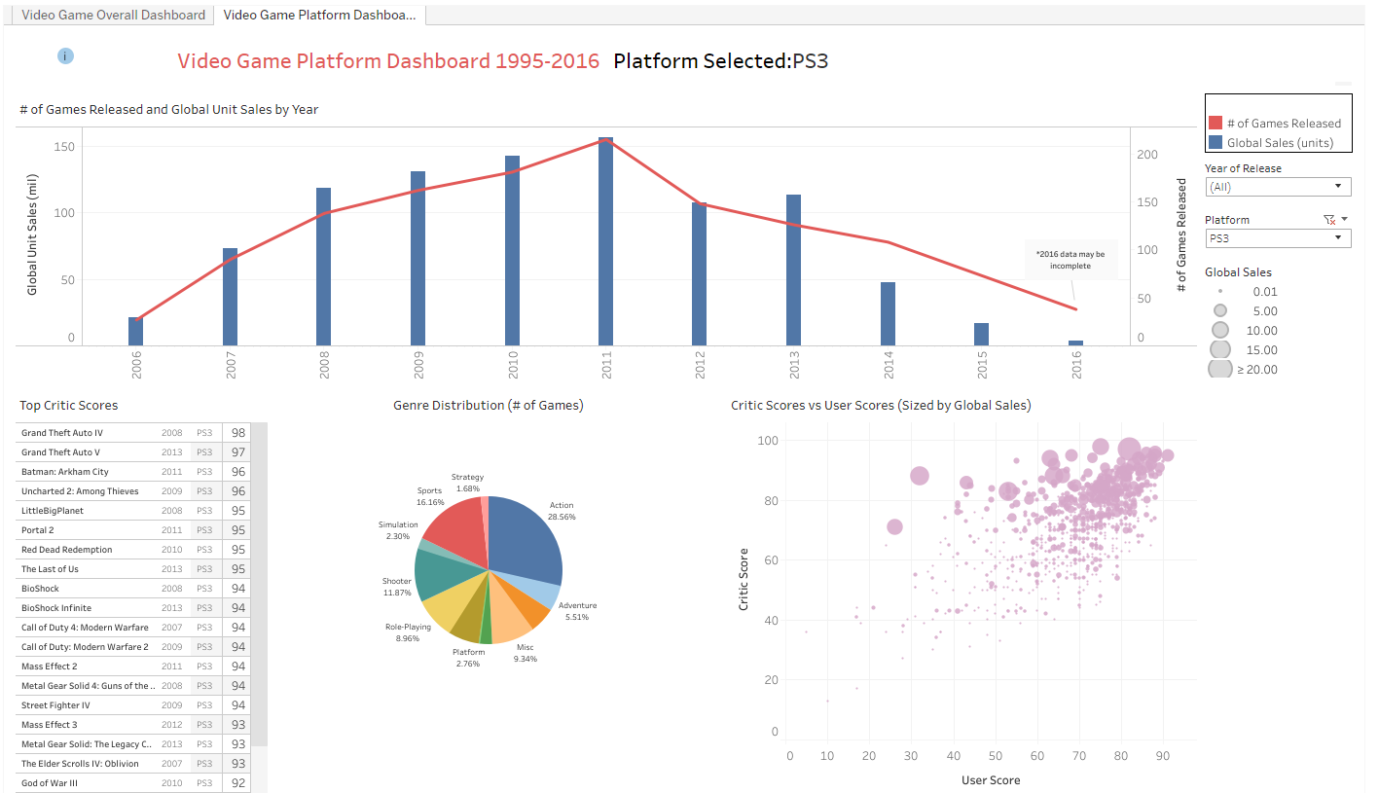
ABC Games Co. can use historical video game market data to create an in-store data resource for game enthusiasts to provide entertainment, increase efficiency in answering game questions, and provide more guidance for customers on which games may be of interest.
Source: Kaggle dataset sourced
from VGChartz.com and Metacritic
Self-Serve Dashboards – Tableau dashboards were developed that customers and employees can use to dynamically filter various metrics and trends as desired by a) Year of Release and b) Game Platform. These dashboards make it easy for games and platforms to be researched for potential future purchases or for fun.
Data Highlights Binders – Certain visualizations and statistics from the dashboard and separate analysis can be printed out and left in “data binders” for customers to look at which can increase their time in the store and knowledge to make purchases.
Data Slideshow Animations – Animations were created that show video game data details and trends over time (examples: platform release volume each year, highest selling game by platform per year, etc). These animations can be played on an in-store monitor for customers to easily see when browsing in the store and may spark additional questions or purchases.

Slide 3
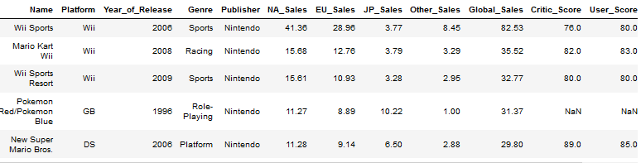



The dataset powering the in-store dashboards and visualizations encompasses games released during 1995-2016 and blends sales data from VGChartz.com with critic/user score data from Metacritic (when available).
Data Source – The data comes from a Kaggle.com dataset that was ultimately sourced VGChartz.com. The date range chosen for in-store data is 1995-2016 because available data before the mid-nineties was lower likely due to a) not as much related sales data being logged for games during those years and b) the overall industry was less widely popular and mature. Metacritic user/critic score and ratings data were also added though roughly half the games are missing a score (mostly older games).
Available Data Columns –
Name
Platform
Year of Release
Data Caveats (also listed under the dashboard info icon):
Games with unit sales of > 10k are included but may not be exhaustive.
Data was collected in late 2016 so 2016 may be missing some late year sales and releases and should be considered “incomplete”
Data has not been updated since 2016 so sales after that are not reflected.
Genre
Publisher
North America Sales
European Union Sales
Japan Sales
Other Sales
Global Sales
Critic Score
User Score
ESRB Rating
Source: Kaggle dataset sourced
from VGChartz.com and Metacritic

Slide 4
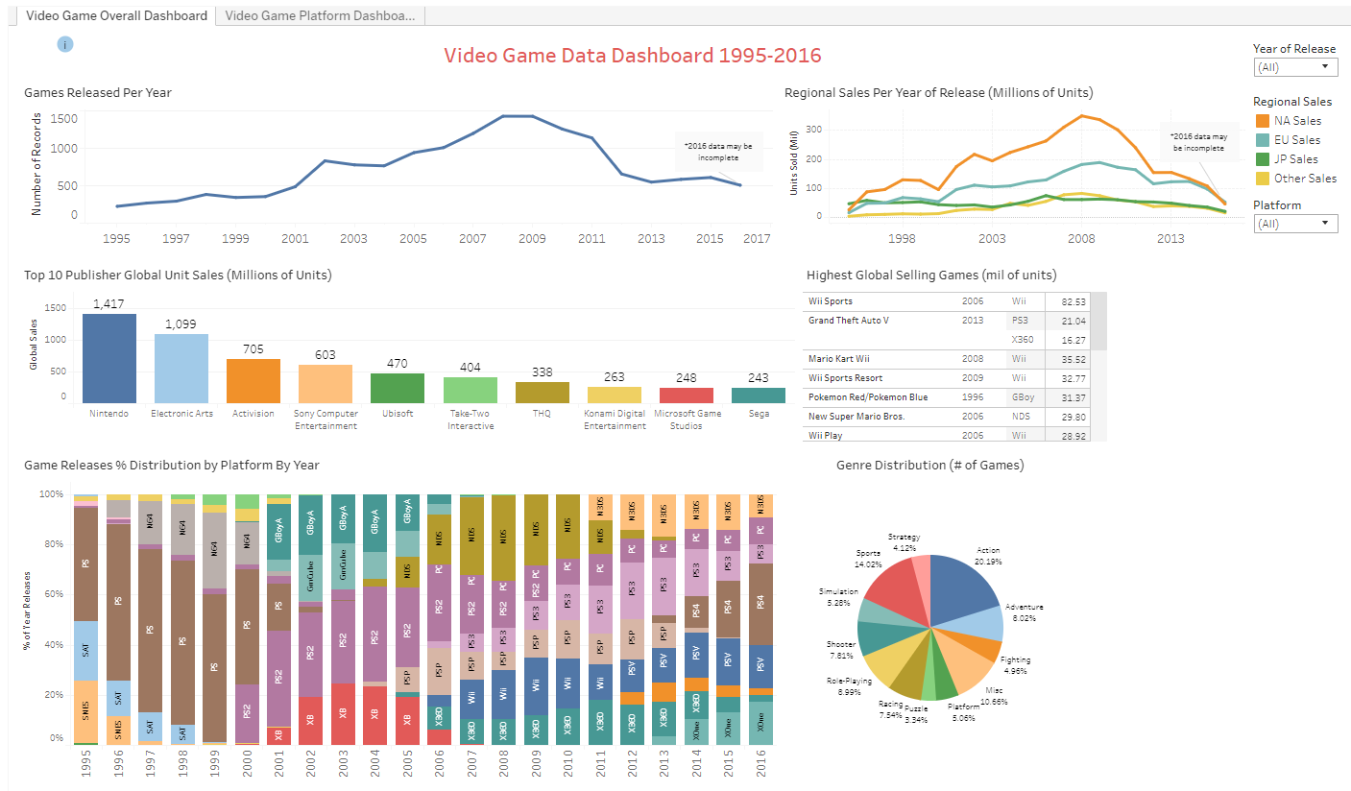
Tableau dashboards were built to allow in-store users to dynamically view and filter various trends and metrics related to video game platforms and release years of interest.
Video Game ‘Overall’ Dashboard – View game release volume per year, regional unit sales per year, Top 10 publishers (in global unit sales), highest selling games, game release volume by genre, and a chart that shows the percentage of unit sales each platform made up each year. All charts except the last are filterable for any desired year or game platform.
Video Game ‘Platform’ Dashboard – A related dashboard with some different charts that show either all platforms or a single filtered platform. View a combo chart of release volume/unit sales by year, top games by critic score, release volume by genre, and a scatterplot of critic score vs user score sized by global sales that shows related information on rollover for individual games.
Interested customers may use these dashboards to answer historical questions, provide guidance from a sales/score level of past games that may be worth purchasing, or for entertainment and another reason to visit the store.
Source: Kaggle dataset sourced
from VGChartz.com and Metacritic

Slide 5
Animated data slideshows were created to show interesting visual representations of key video game trends over time, and these can play on in-store monitors as an added attraction.
* View slide in slideshow mode to see the charts animate
Ex: Game Release Volume by Platform by Year
Ex: Highest Selling Game by Platform by Year
Platform bars keep same colors across years to more easily see trends
Speed of animations can be adjusted
Initial animations created are Game Release Volume by Platform by Year, Highest Selling Platforms by Year, and Highest Selling Game by Platform by Year. Additional ones can be created based on customer feedback and requests.
Source: Kaggle dataset sourced
from VGChartz.com and Metacritic

Slide 6
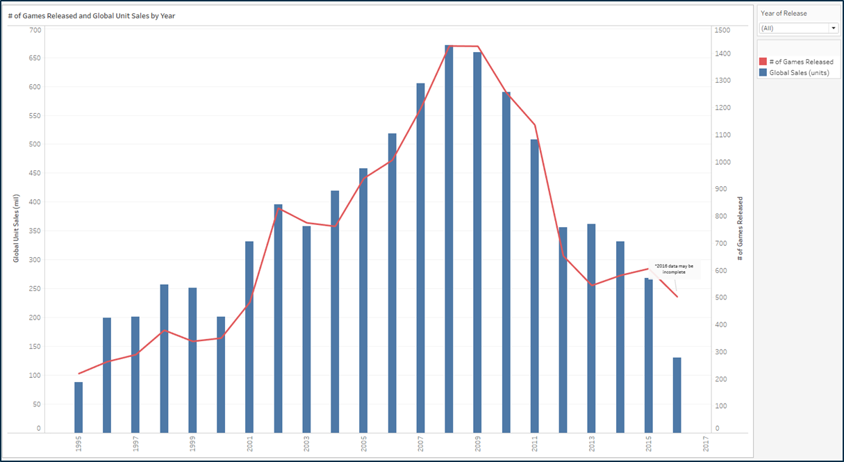
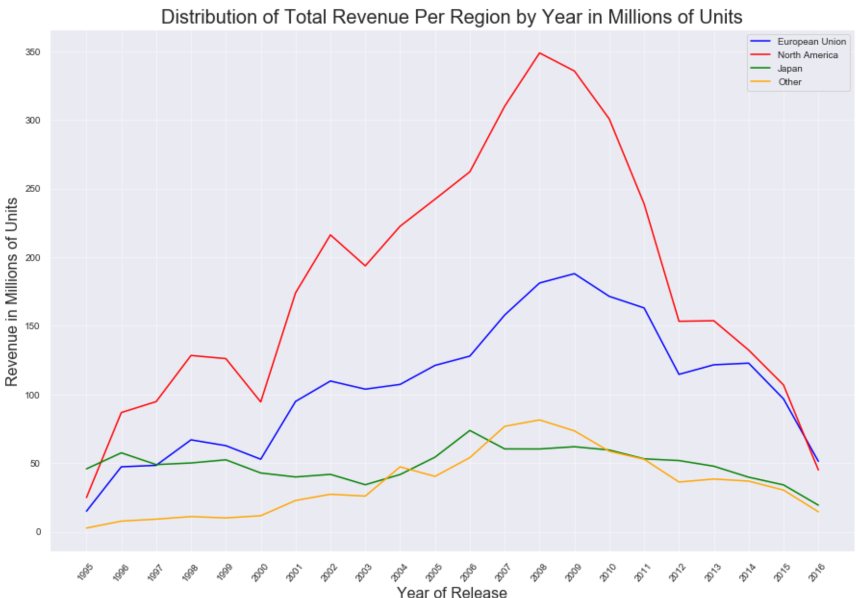
Video game overall yearly graphs show visual trends for game release volume and unit sales that paint a picture of overall video game industry adoption and popularity (as well as platform-specific).
# of Games Released and Global Unit Sales by Year
# Unit Sales by Region by Year
The 'peak' period of the date range for game release volume is 2002-2012 with 2008 and 2009 being the top years having more than 1400 games released per year. All years had over 200 games released and 1995 had the least amount with just over 200 games.
Game sales are consistently significantly higher in North America than other regions every year except the first (1995) and last (2016). All 4 regional sales have roughly the same line shape, indicating they generally increase or decrease together each year (Japan appears to be the most different, staying relatively flat or decreasing during the peak periods of 2004-2009, while the other 3 regions steadily increase.)
Source: Kaggle dataset sourced
from VGChartz.com and Metacritic

Slide 7
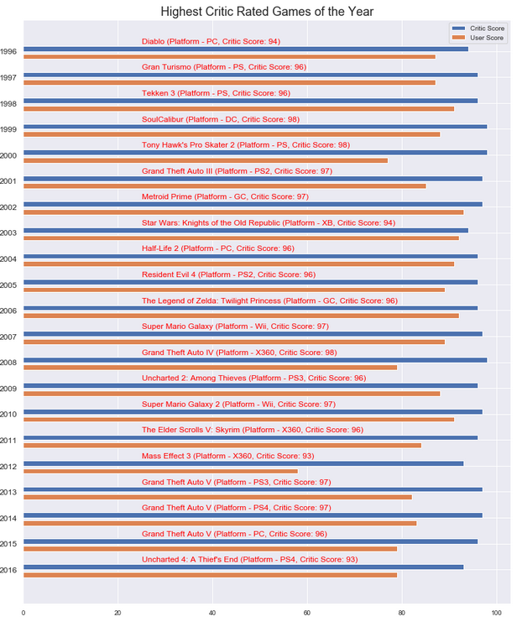
A key visualization listing the best critic-reviewed game of every year across all platforms was generated to show one option for those customers looking for the ‘best’ games to buy from past years.
While the ‘game of the year’ is shown by critic score, an associated user score bar is shown right below to show the comparison (did they agree?)
PC and Sony Playstation lead the way with 3 games apiece (though PC doesn’t have different platform ‘versions’ throughout the years)
There's a 3-way tie for the game with the highest critic score - 1999's SoulCalibur on DC, 2000's Tony Hawk's Pro Skater 2 on PlayStation, and 2008's Grand Theft Auto IV on XBox 360 all have a score of 98. Since they are tied, a reasonable way to break the tie is use the associated User Score which leads to SoulCaliber on Sega Dreamcast being the highest rated game in the dataset.
Source: Kaggle dataset sourced
from VGChartz.com and Metacritic

Slide 8
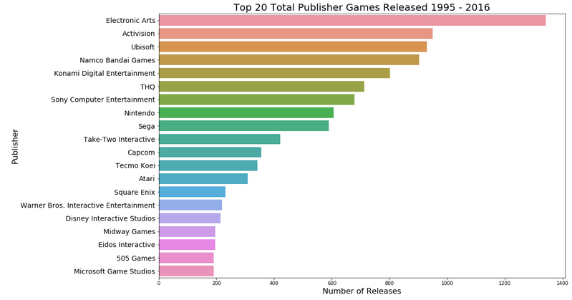
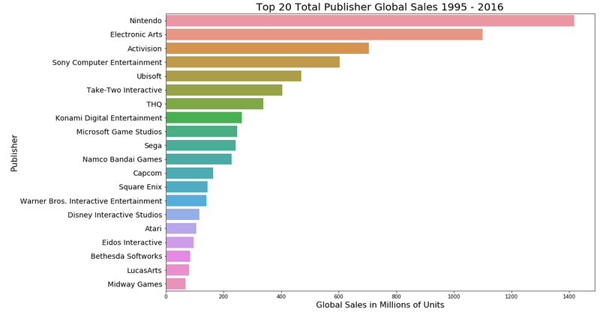
Game release volume and sales by publisher show the clear leaders in terms of what companies are ultimately releasing games and could influence game purchases by consumers who want to stick with proven companies over time.
Source: Kaggle dataset sourced
from VGChartz.com and Metacritic
Games Released by Publisher
Global Sales by Publisher
Electronic Arts is clearly the leader in games released with over 1300 games from 2000-2016. This is over 40% higher than the next highest - Activision. The top 20 publishers make up close to 2/3 the entire volume of games, accounting for 10,375 games.
When switching to look at the top 20 publishers by units sold (vs games released), Nintendo is the clear leader with over 1.4 billion games sold (while it was 8th in terms of games released). While the top 20 publishers in units released make up 2/3 of that total, the top 20 publishers for units sold make up 86% of the total.
The dashboard gives additional publisher metrics on rollover and from this it is apparent that Nintendo has the highest average user score per game at 79.16. Given Nintendo’s enduring popularity across numerous platforms, it’s not a surprise that users love the games. This also explains why it leads in sales volume but is just 8th in games released – it sells more per game (likely due to that high user sentiment).

Slide 9
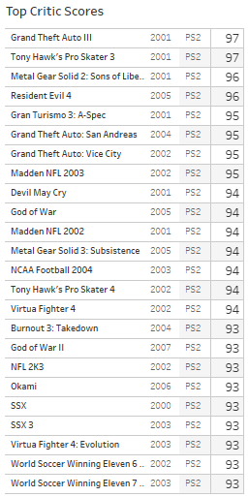
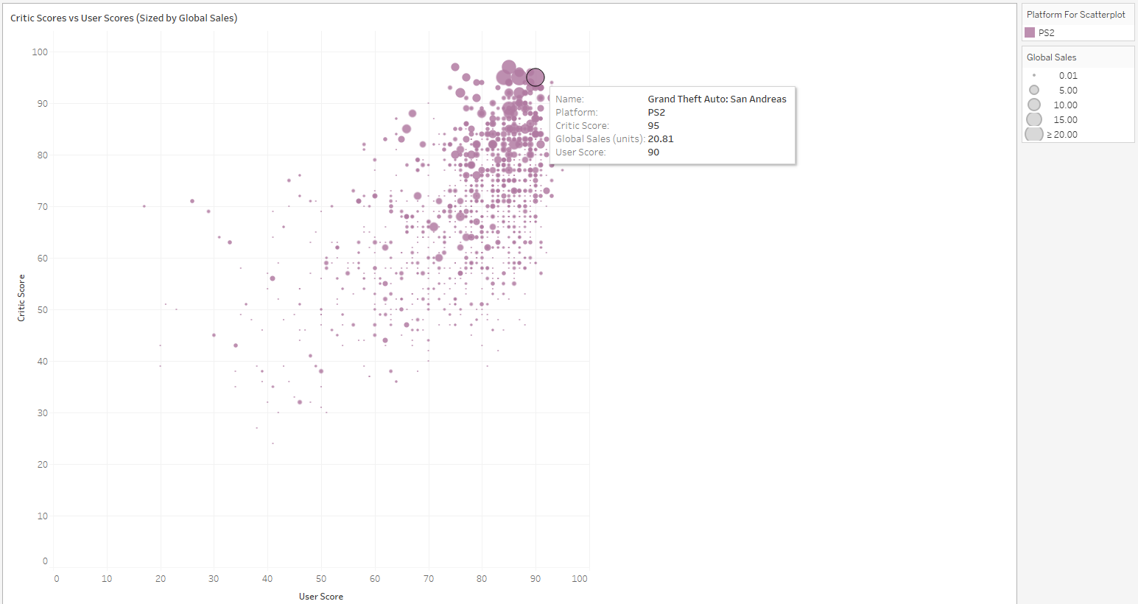
Critic scores and user scores (sourced from Metacritic) are shown to provide an important game quality indicator for customers (or to provide a catalyst for a fun debate among gamers).
Source: Kaggle dataset sourced
from VGChartz.com and Metacritic
Top critic scores (filtered as desired) are available on the “Platform” dashboard to immediately show the ‘best’ games as determined by game critics
A scatterplot of critic score vs user score (sized by global sales) is available on the dashboard to visually see where games fall on the intersection of the critic/user score scale (hint: upper right is good, lower left is not) and display info on rollover.

Slide 10
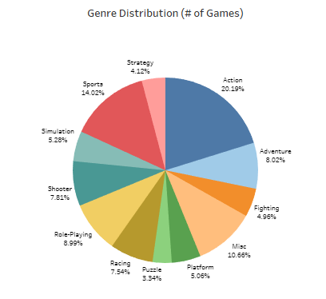
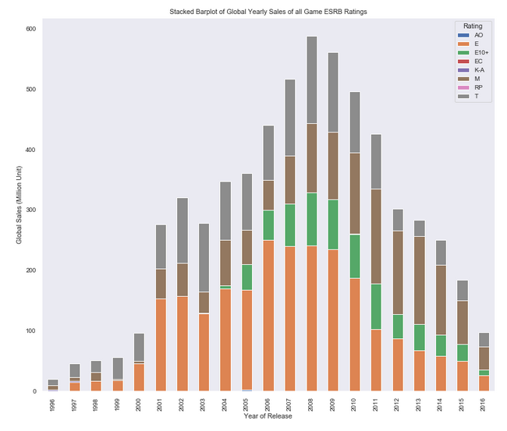
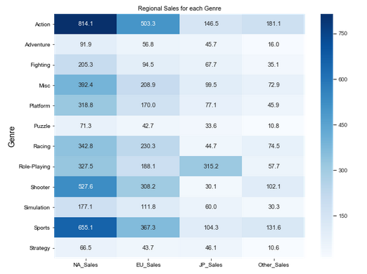
Showing video game information by genre and ESRB rating gives useful insight to customers interested in (or wanting to exclude) certain content in games.
Source: Kaggle dataset sourced
from VGChartz.com and Metacritic
Global Yearly Sales of Games by ESRB Rating
Action and Sports genres appear highest from a release volume standpoint as well as regional sales across all regions with Strategy and Puzzle showing the lowest. An interesting callout from the data is the Role-Playing genre for Japanese Sales - by far the highest in that region indicating Japanese gamers often favor Role-Playing games more than other genres.
When looking at game ESRB (Entertainment Software Rating Board) rated games, ‘Mature’ rated games sales proportions have been increasing since 2011 while 'Everyone' rated games have been decreasing in proportion.
“Heatmap” of Regional Sales by Genre

Slide 11
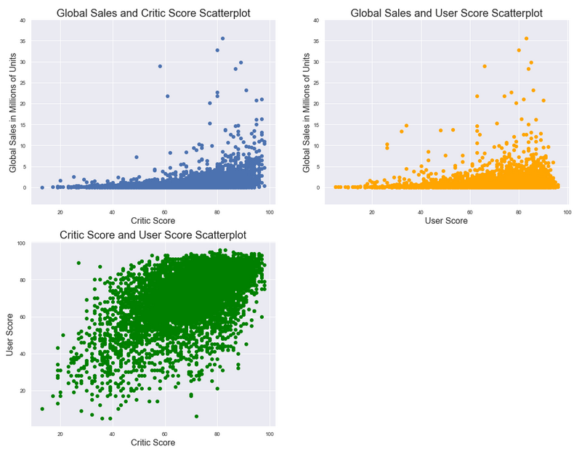
Overall game sales and scores appear to have a slight (but not strong) positive relationship, while critic and user scores are more directionally similar.
Overall, scores likely aren't a strong predictor of sales (and vice versa) by themselves.
User and critic scores have a stronger positive relationship. It's reasonable that often user and critic scores move similarly when reviewing video games, but there are enough instances of them behaving differently for the relationship to not be considered ‘very strong’.
User scores are slightly higher on average overall than critic scores when looking at the entire dataset though that will of course vary by each game.
The highest selling games don't have very low scores and usually have higher than average scores. There are a few more individual cases of higher selling games with lower user scores than lower critic scores.
Source: Kaggle dataset sourced
from VGChartz.com and Metacritic

Slide 12
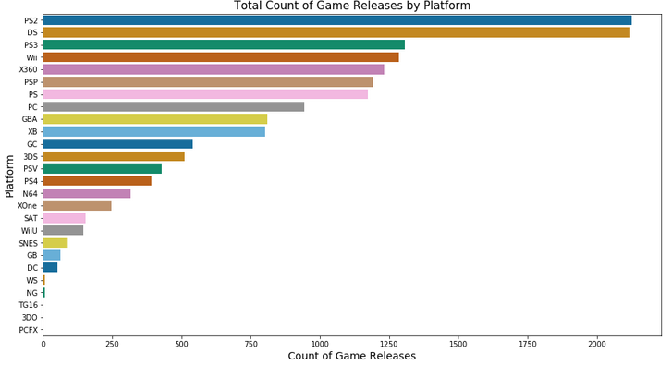
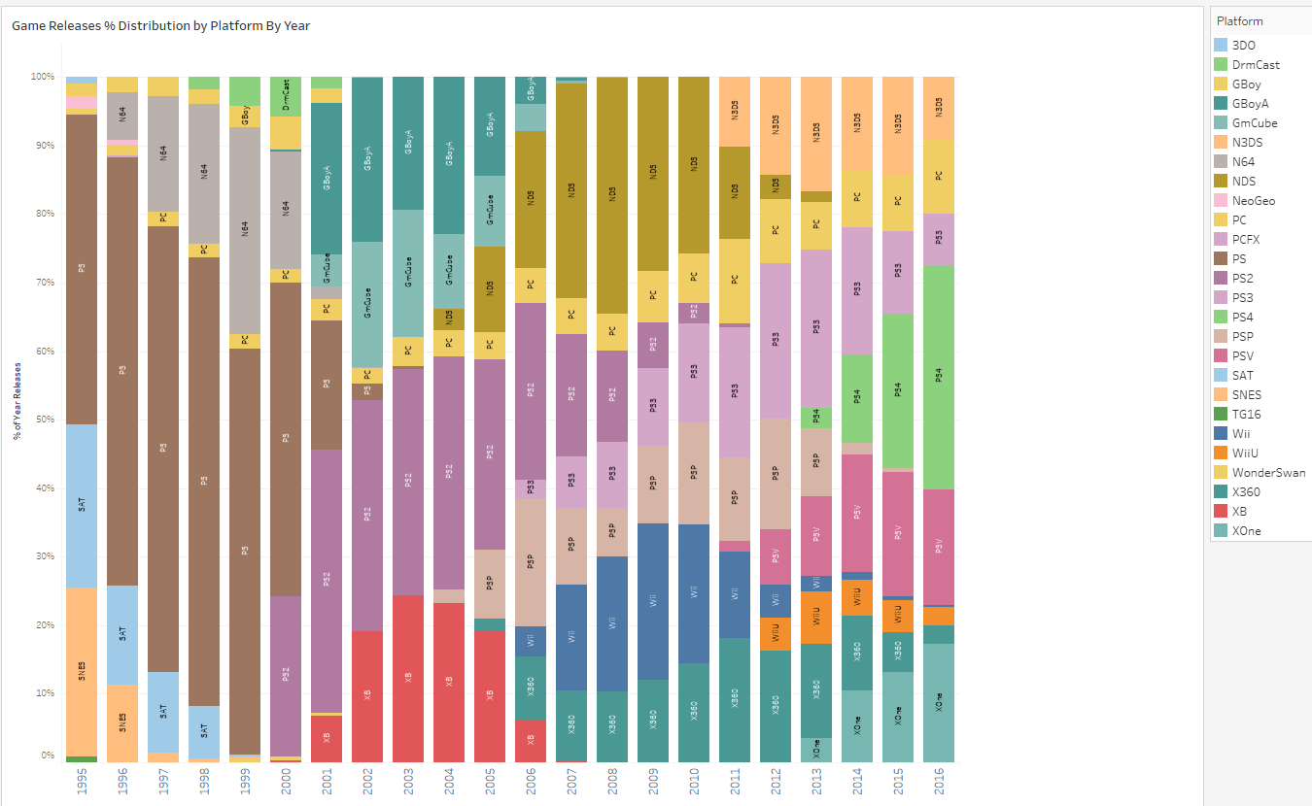
Gamers often have their favorite platform companies they are loyal to, and various data charts show key platform info and trends throughout the years.
Source: King County WA May 2014-May 2015 Housing Data (Kaggle)
For this dataset spanning 1995-2016, the platform with the most releases is Playstation 2 followed closely by Nintendo DS with both having more than 2000 games included. These are ~40% more than the next highest game system (Playstation 3). 26 different platforms have games released during the time period.
A game release % distribution by platform by year chart is provided to visually see the years each platform had its ‘era’ and how it stacks up with other platforms comparatively. While Sony and Nintendo have a significant representation in the majority of years, Sega (a major player in the 90’s) died off around 2000 after the Saturn and Dreamcast ran their course.

